Slide 1
Emergency Action Plans
Standard 29 CFR 1910.38
Presented by: Barton Insurance Group LLC
© 2005, 2020 Zywave, Inc. All rights reserved.

Slide 2
Learning Objectives
After this training program, participants will understand:
  What is covered under our emergency action plan (EAP)
  What situations may require employees to evacuate
  What situations may require employees to shelter in place
  What to do in a medical emergency
  How to respond to incidents of workplace violence

Slide 3
Why Have an EAP?
An EAP establishes planned responses for hazardous situations, ensuring safety following sudden, dangerous incidents.
Having a detailed plan in place ensures employees know what to do in emergencies, which in turn promotes calm, organized response efforts.
In the event of an emergency, employees should carefully follow our EAP. Failing to do so could worsen the situation or even create additional hazards.

Slide 4
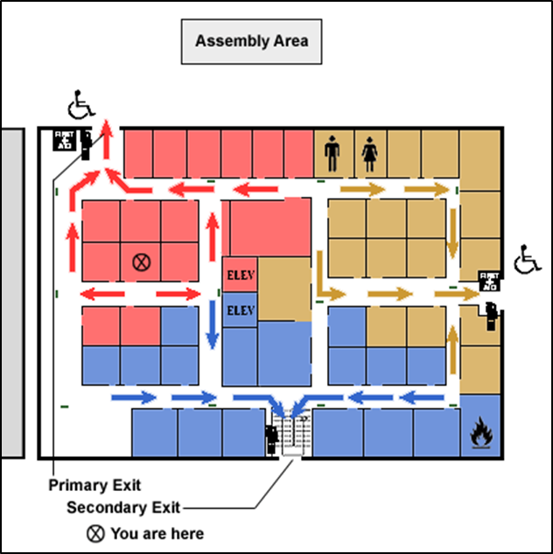
What’s in Our EAP?
Evolution Maintenance, Inc’s EAP outlines:
How employees can report fires and other emergencies
Evacuation procedures and emergency escape route assignments
Procedures for employees who may need to operate critical plant operations before they evacuate
How Evolution Maintenance, Inc will account for all employees after an emergency evacuation has been completed
Rescue and medical duties
Names or job titles of persons who can be contacted in emergencies
Note: This is an example floor plan. It doesn’t represent our official floor plan or exit procedures.

Slide 5
Situations That May Require an Evacuation
Certain emergencies may require employees to evacuate the facility. Fires are the most common reason for this, but evacuation could also be triggered by:
  Explosions
  Floods
  Chemical releases
  Structural failures
  Civil unrest
  Active shooter incidents

Slide 6
Our Emergency Communication Methods
If our facility needs to be evacuated for an emergency, you will be notified by these means:
  Primary Methods
    [Insert communication method]
    [Insert communication method]
    [Insert communication method]
  Secondary Methods
    [Insert communication method]
    [Insert communication method]
    [Insert communication method]

Slide 7

Emergency Exit Routes
There are three main elements of an exit route:
  The path to the exit
  The exits themselves
  The path away from the building once you’ve exited

Slide 8
Emergency Exit Routes (Continued)
Exit routes will be:
  Clearly marked and well lit
  Wide enough to accommodate the number of evacuating personnel
  Unobstructed and clear of debris at all times
  Unlikely to expose evacuating personnel to additional hazards
In general, floor plans will include the locations of exits, assembly points and equipment (e.g., fire extinguishers, first-aid kits and spill kits) that may be needed in an emergency.

Slide 9
Responding to Fires
Alert others who may be at risk.
Notify a member of management.
Activate the fire alarm.
Turn off any equipment involved in the fire.
Consider using a fire extinguisher if you are trained and authorized to do so.
Evacuate if necessary.

Slide 10
Evacuating in the Event of a Fire
Turn off equipment if it’s safe to do so.
Walk—in an orderly and quiet manner—to the exit closest to you that’s not blocked by fire, smoke or other hazards.
Exit the building.
Do not delay evacuation or reenter hazardous areas to retrieve personal possessions, such as keys, coats or purses.
Report to the designated evacuation location for a head count.
Stay together with your assigned group until further instructions are given.
Do not reenter the building until you are told it is safe to do so by your supervisor or another member of management.

Slide 11
Fire Evacuation Plan
In the event of a fire, our evacuation location is:
  [Insert details]

Slide 12
Respond to Hazardous Chemical Spills or Releases
Responding to hazardous chemical spills or releases is similar to our procedures during a fire, but with additional precautions:
  Avoid evacuating through the hazardous chemical spill or release.
  Stay upwind.
  Shelter off-site if applicable (will depend on the type of the release).

Slide 13
Responding to Severe Weather
Tornadoes and other severe weather may require employees to shelter in place.
To alert employees to severe weather, we employ the following methods:
  [Insert communication method]
  [Insert communication method]
  [Insert communication method]
It is critical to know the difference between the shelter-in-place alarm and the evacuation alarm.

Slide 14
Responding to Severe Weather (Continued)
Turn off all equipment if it safe to do so.
Walk—in an orderly and quiet manner—to the designated severe weather evacuation location. There, a head count will be conducted to account for all personnel.
Wait to leave the evacuation location until you are given the all-clear from management. Even after a severe weather warning has expired, it may not be safe outside of the shelter area.

Slide 15
Responding to Severe Weather (Continued)
In the event of severe weather, our evacuation location is:
  [Insert details]

Slide 16
Responding to Medical Emergencies
Notify a member of management.
Evaluate the safety of the scene. If there are any safety concerns, all personnel should stay at a safe distance.
Do not move the ill or injured person unless they are endangered by the surroundings.
Avoid all contact with blood and other bodily fluids.
Never attempt to provide first aid unless you are trained and equipped to do so. Those trained in first aid must use the appropriate personal protective equipment.

Slide 17
Responding to Medical Emergencies (Continued)
A calm employee may stay with the ill or injured person to provide comfort until more help arrives.
The supervisor will assign at least two employees to meet emergency medical service responders at the door and guide the them to the scene.
All uninvolved personnel should clear the area.
If there has been any blood or bodily fluid release, trained personnel will clean and sanitize the area after the emergency has been resolved.

Slide 18
Responding to Power Outages
Notify a supervisor or member of management if the failure only affects a part of the facility.
Turn off equipment using normal controls.
Expect a sudden equipment restart. Stay away from the point of operation and other moving surfaces.
Do not attempt to move around dark areas. Supervisors will use flashlights to guide you to a safe area to wait for power restoration.
After power is restored, follow your supervisor’s directions for equipment restart.

Slide 19
Responding to Workplace Violence
Workplace violence is any violent act directed toward a person at work or on duty. These acts are classified into four types of situations:
  Criminal—The perpetrator has no legitimate relationship to the business or its employees and generally commits a crime in conjunction with the violence (e.g., shoplifting, robbery or trespassing).
  Customer or client—The perpetrator has a legitimate relationship with the business and becomes violent while being served by the business.
  Co-worker—The perpetrator is a current or past employee, or is a contractor who works as a temporary employee of the business.
  Domestic violence—The perpetrator has no legitimate relationship with the business, but has a personal relationship with a victim, and threatens or assaults him or her at the workplace.
Workplace violence situations are very unpredictable and can change rapidly. As such, it’s critical employees know what to do in these scenarios.

Slide 20
Responding to Workplace Violence (Continued)
Notify a member of management immediately if:
  You witness a violent act.
  You witness a threat of violence.
  You believe that a violent act may occur.
If you are in the vicinity of a violent or threatening person, get away as soon as possible, notifying others who may also be at risk.
If you are advised by a member of management that a workplace violence incident may be occurring, follow their directions immediately.

Slide 21
Responding to Workplace Violence (Continued)
In the event of suspected gunfire, employees should:
  [Discuss company protocols]
  [Discuss company protocols]
  [Discuss company protocols]
  [Discuss company protocols]
Above all, employees should follow the instruction of supervisors and any law enforcement officials who are responding to instances of workplace violence.

Slide 22
Summary
Remember the methods used to alert you of an emergency in the facility.
If you discover an emergency you must always:
  Alert others who are in immediate danger.
  Notify a member of management.
Remember your evacuation locations for fire/chemical spill or release, and for severe weather.
React quickly and calmly in the event of any emergency.

Slide 23
For More Information
For more information regarding emergency action plans or other safety issues, please contact:
Barton Insurance Group LLC
www.bartoninsurancegroupllc.com
615.806.1265

